Slide 1
Final Project Design Implementation:
Introduction
CDT 1
CDT 2
CDT 3

Slide 2
Roles & Responsibilities
NAME | Responsibilities
CDT 1 | Group Leader ; Security Implementation + NAT Implementation
CDT 2 | Layer 3 Implementation + Telephony Services
CDT 3 | Layer 2 Implementation + ACL Implementation

Slide 3
Timeline
Tasks to be completed | Deadlines
Presentation | 23 MAY 2020
Network Configuration | 26 MAY 2020
Security Implementation | 28 MAY 2020
Preliminary Testing | 29 MAY 2020
Initial Functional Test | 1 MAY 2020
Final Functional Test | 4 MAY 2020
1.) All tasks will be completed by the deadlines by all members of the team
2.) All members will work together so that we understand each component of the Final Project

Slide 4
Collaboration & Testing
Goals:
Start Early - End Early
Course of Action / Group Collaboration:
All group members work together and through each section of the project
All group members check the work of one another before deadlines
Packet Tracer Implementation:
all work together on one computer and distributes the one file on MS Teams
Step 1: Ensure that all subnetting chart & concepts are accurate
Step 2: Configure all devices and interfaces in Packet Tracer according to our charts and subnet charts
Step 3: Implement Security Measures, OSPF, EIGRP, ACLs, NAT

Slide 5
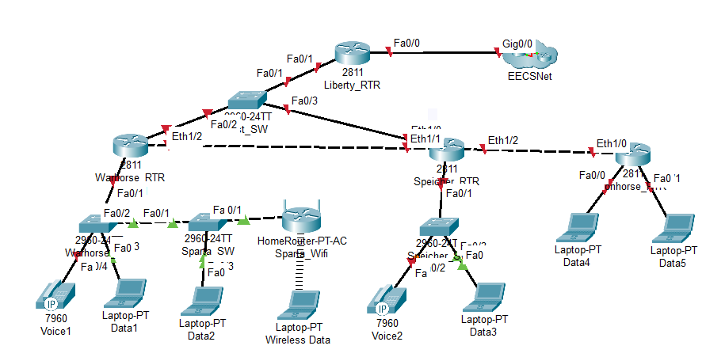
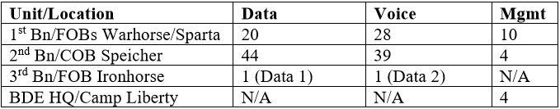
Requirements
Mission: Given 10.64.1.0 /24. Satisfy all the requirements specified for the final project design.
IP Requirements

Slide 6
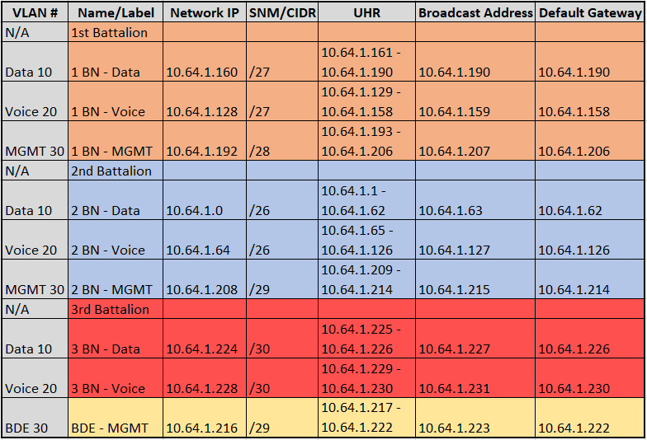
Subnetting Chart

Slide 7
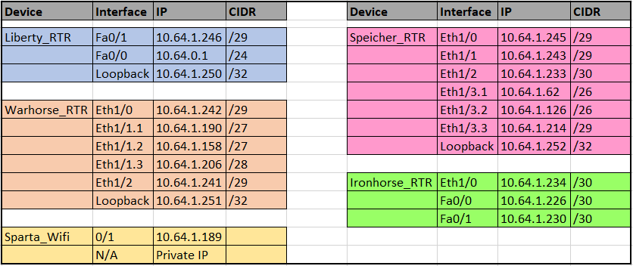
Layer 3: Interface IP

Slide 8
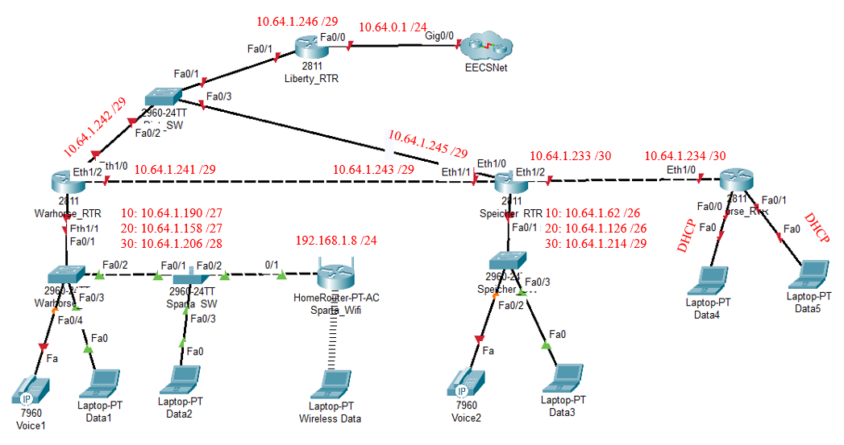
Layer 3: IP Address Scheme

Slide 9

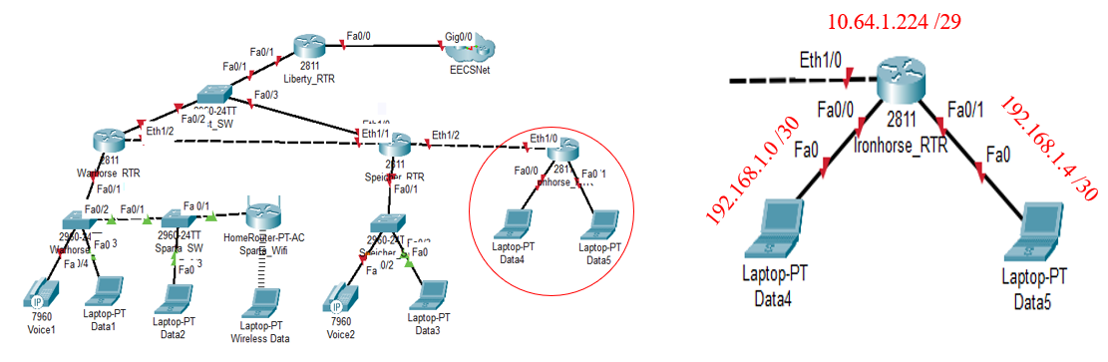
NAT Translation

Slide 10
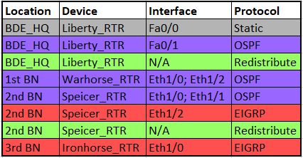
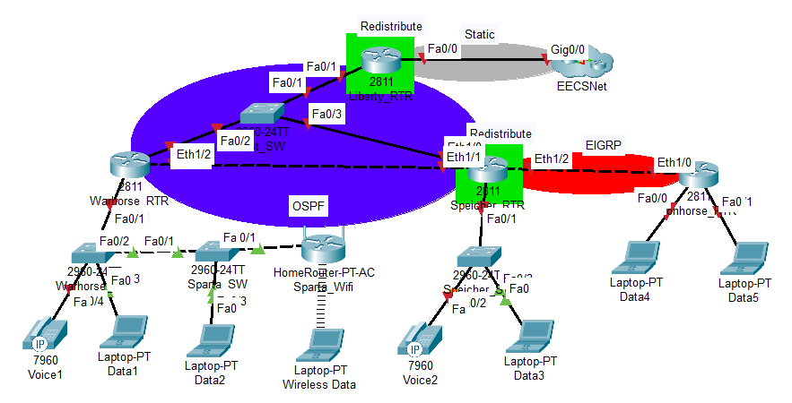
Layer 3 Protocols

Slide 11
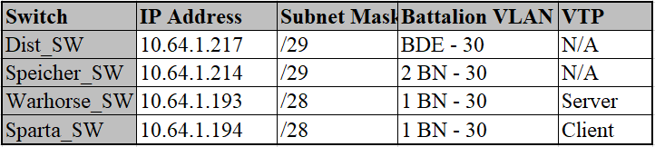
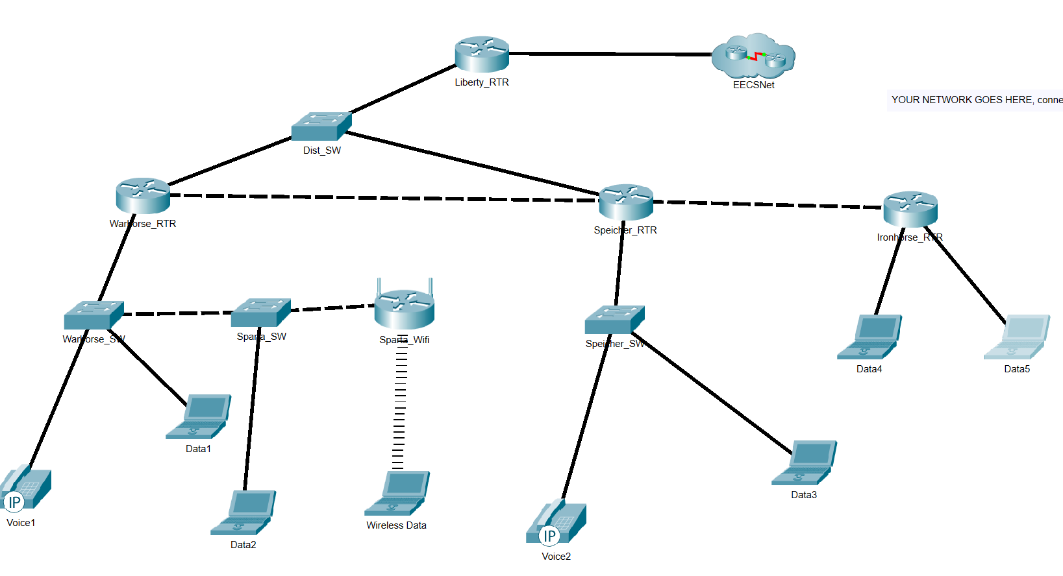
Layer 2 Diagram

Slide 12
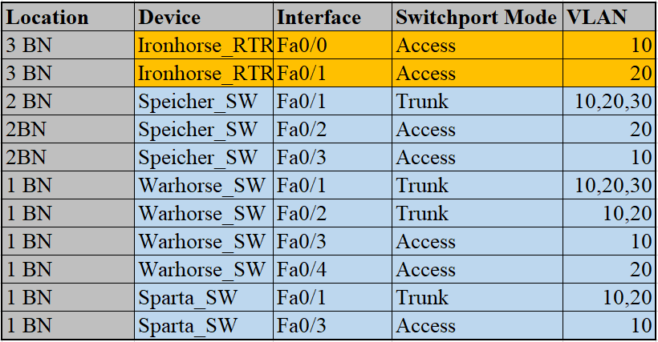
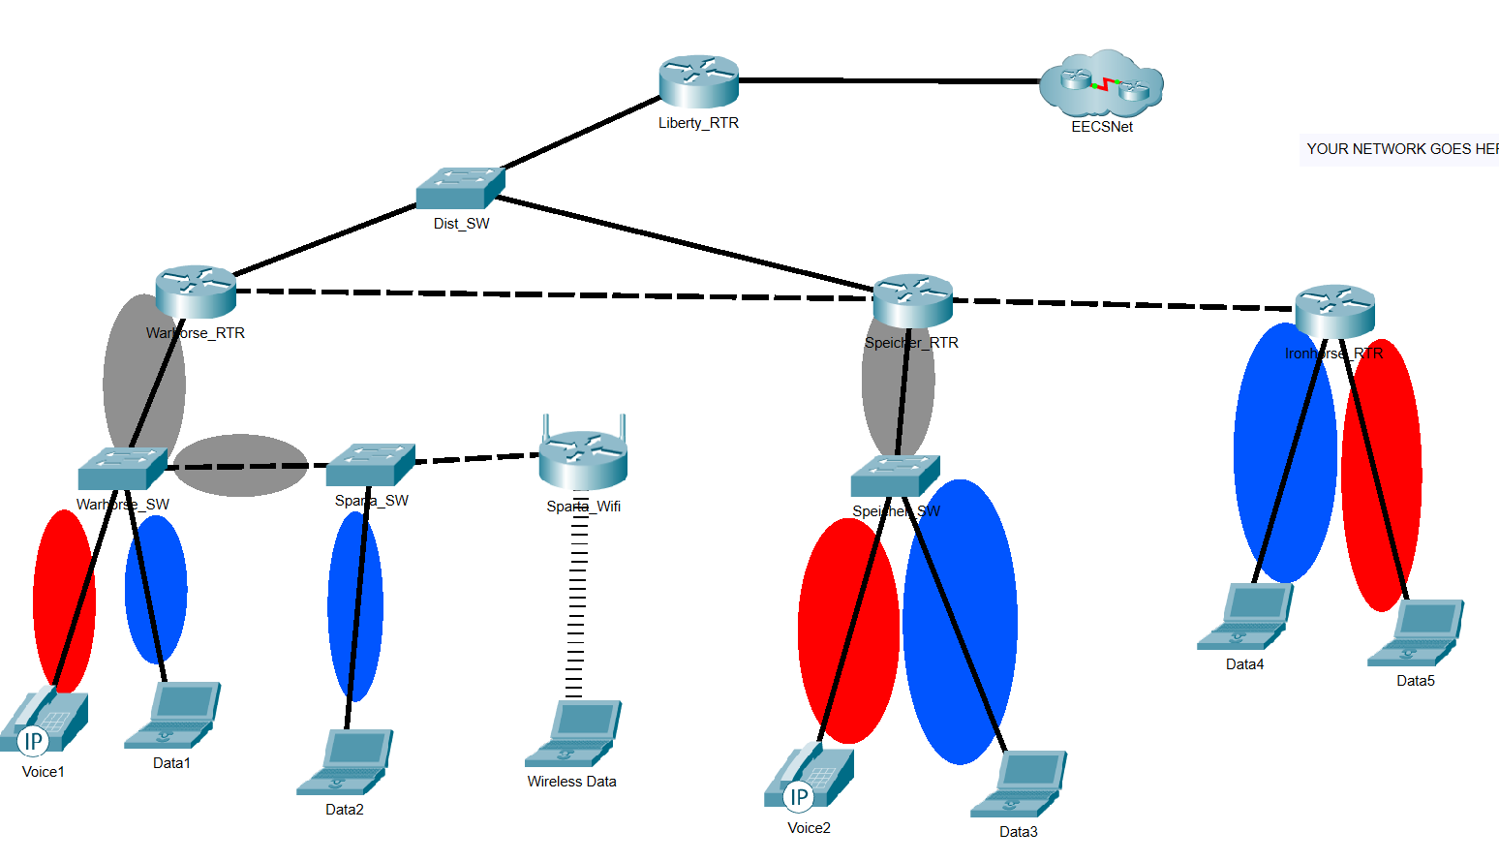
Switchport & VLANs

Slide 13
Security Diagram
Ext ACL 50:
Fa0/0 (inbound)
Permit
?

Slide 14
Security ACL Implantation
EXT ACL SSH_Connection
Eth 1/1.3 (inbound)
?
Warhorse MGMT net to :
?
EXT ACL SSH_Connection
Eth 1/0 (inbound)
Permit ?
EXT ACL SSH_Connection
Eth 1/3.3 (Inbound)
Permit SSH from COB Speicher MGMT Net to :
?

Slide 15
Security ACL Implementation
EXT ACL 101
Eth 1/1.1 (inbound)
Permit:
?
EXT ACL 101
FA 1/1 (inbound)
Permit
?
EXT ACL 101
Eth 1/3.1 (Inbound)
Permit :
?

Slide 16
Security Implementation
EXT ACL PING1
Eth 1/1.1 (inbound)
Permit ping (“echo”) to:
?
EXT ACL PING1
Eth 1/3.1 (inbound)
Permit ping (“echo”) to:
?

Slide 17
Security Implementation
EXT ACL PING2
?
EXT ACL PING2
?

Slide 18
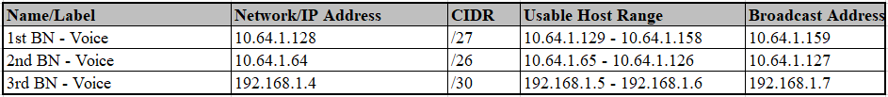
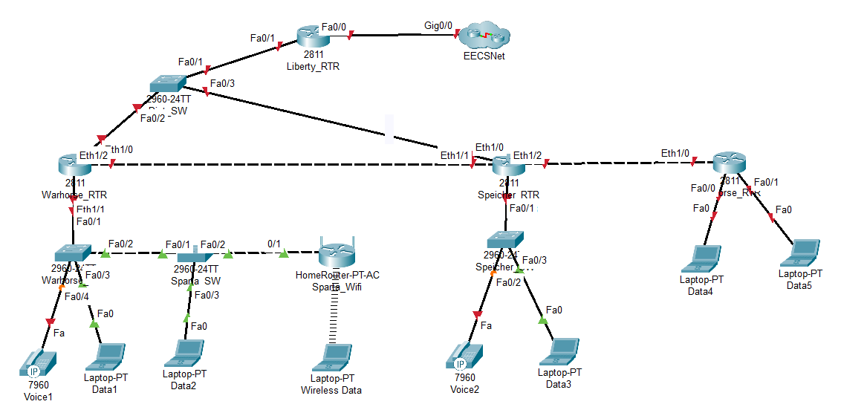



Telephony Services

Slide 19
Works Cited
Redman, Marcus A3 ’21. Assistance given to the authors?

